Slide 1
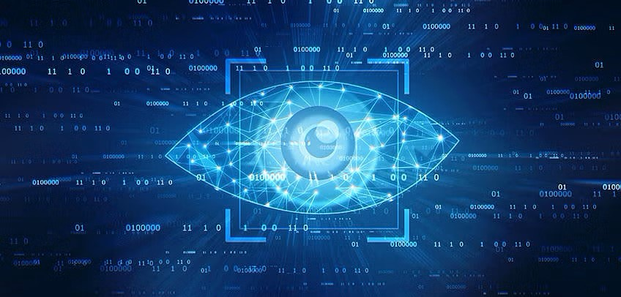
Computer Vision

Slide 2
Table of Contents
What is Computer Vision?
How Does Computer Vision Work?
History
Deep Learning Revolution
How Long Does It Take To Decipher An Image
What Is an Image?
What Is Image Processing?
Types of Image Processing
Fundamental Image Processing Steps
Applications of Image Processing

Slide 3
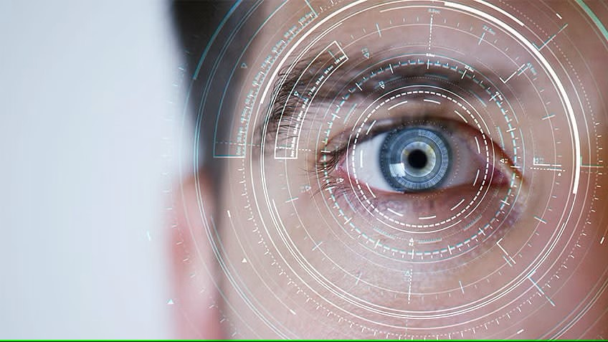
What is Computer Vision?

Slide 4
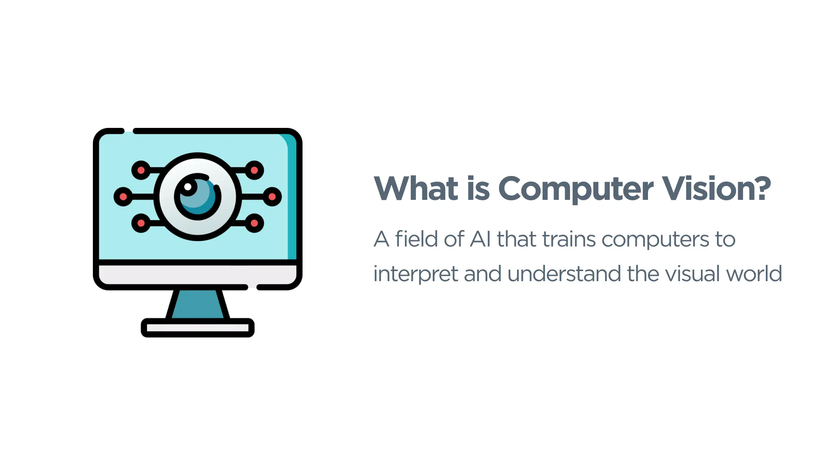

Slide 5
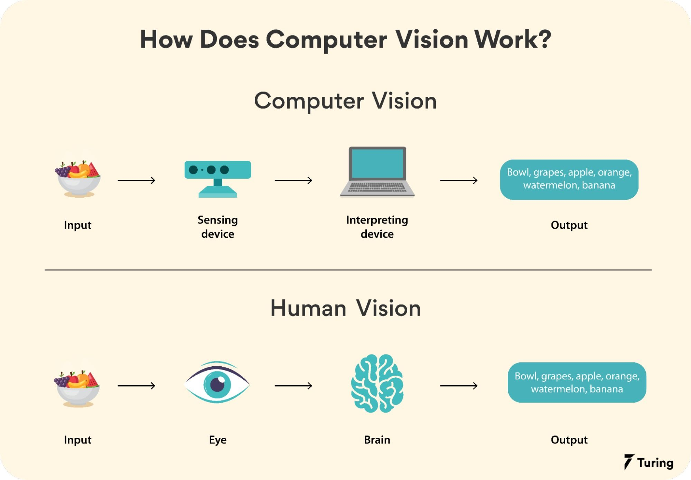

Slide 6
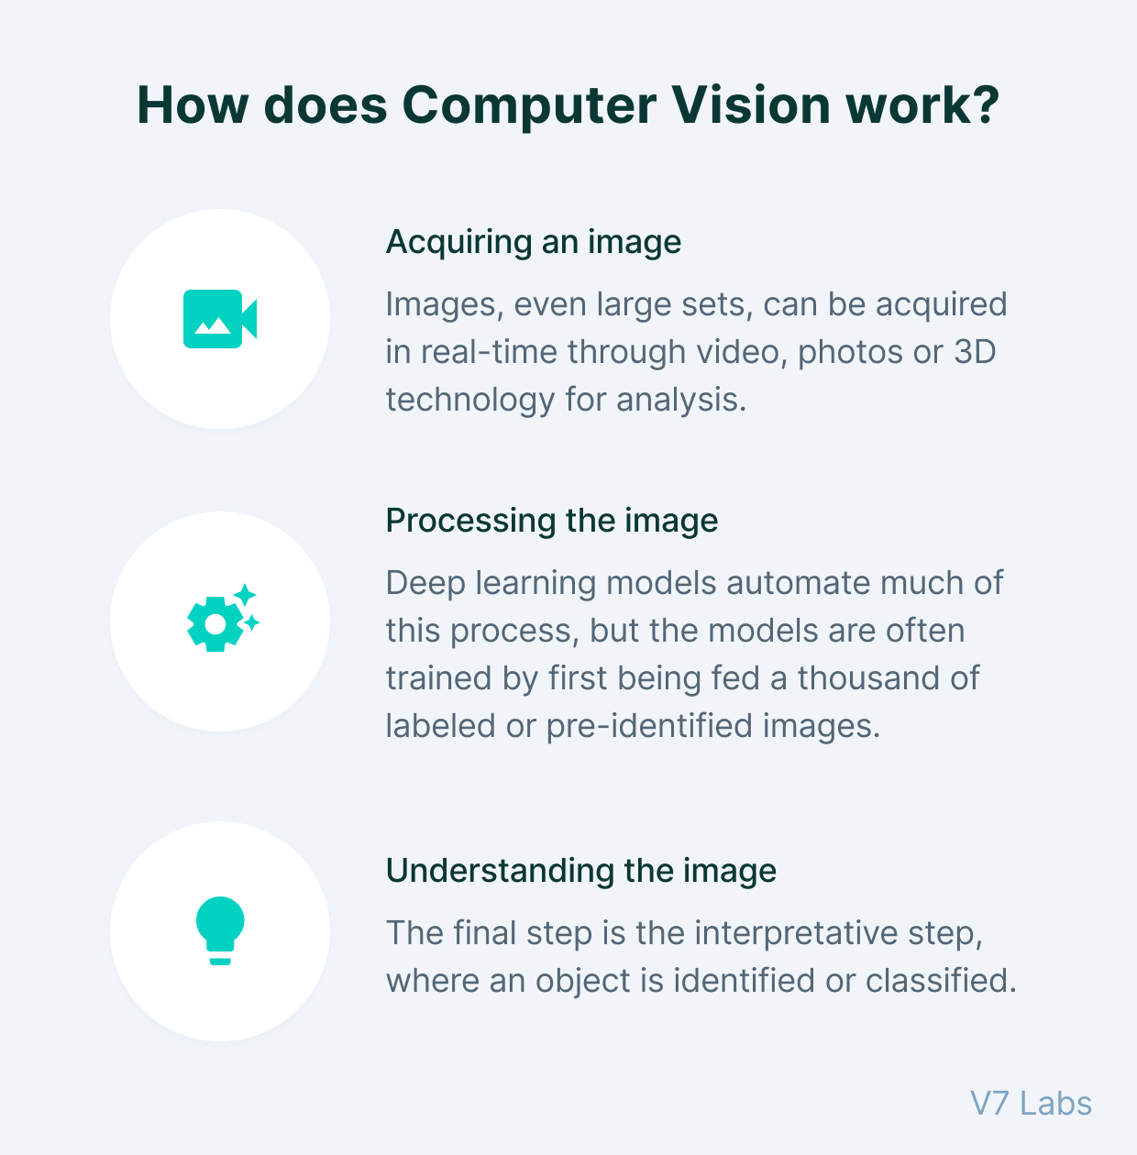

Slide 7
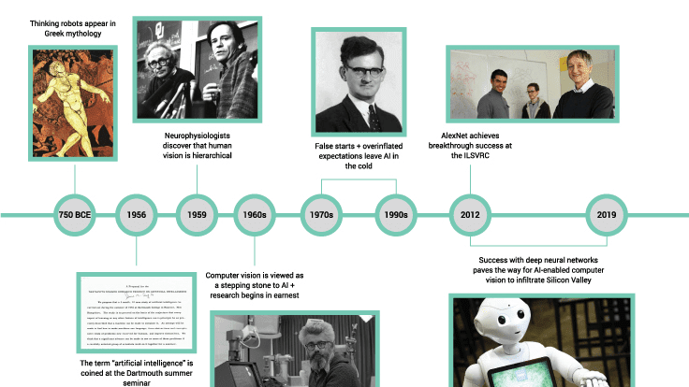

Slide 8
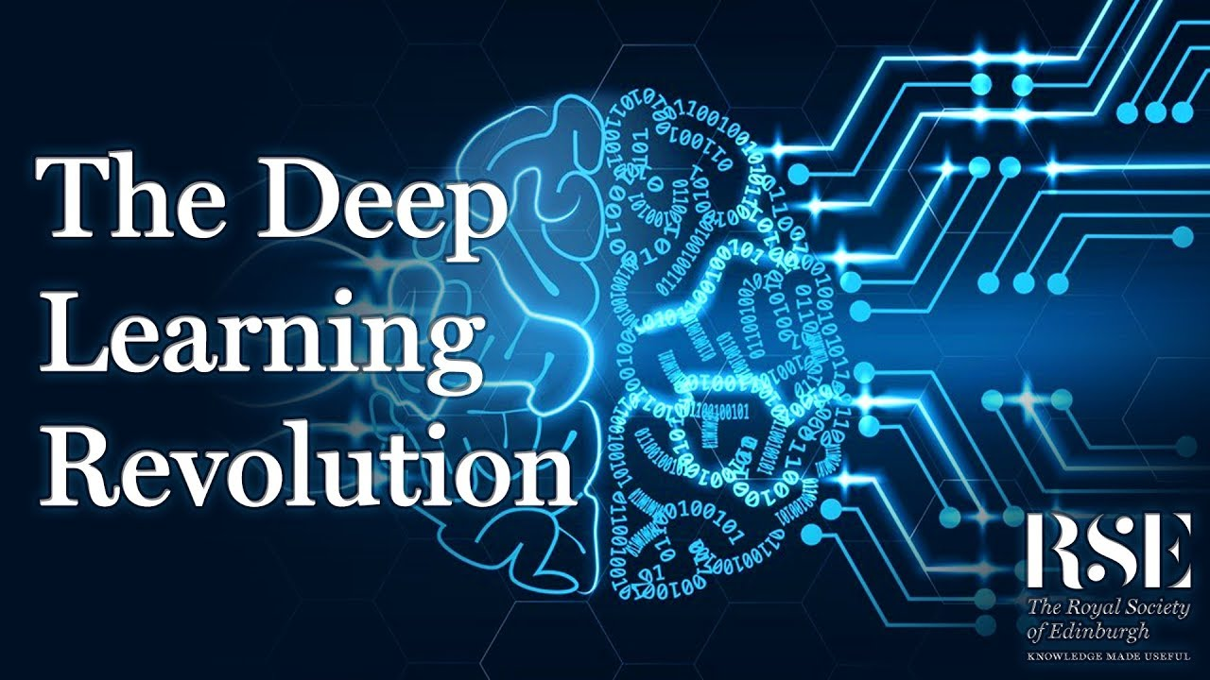

Slide 9
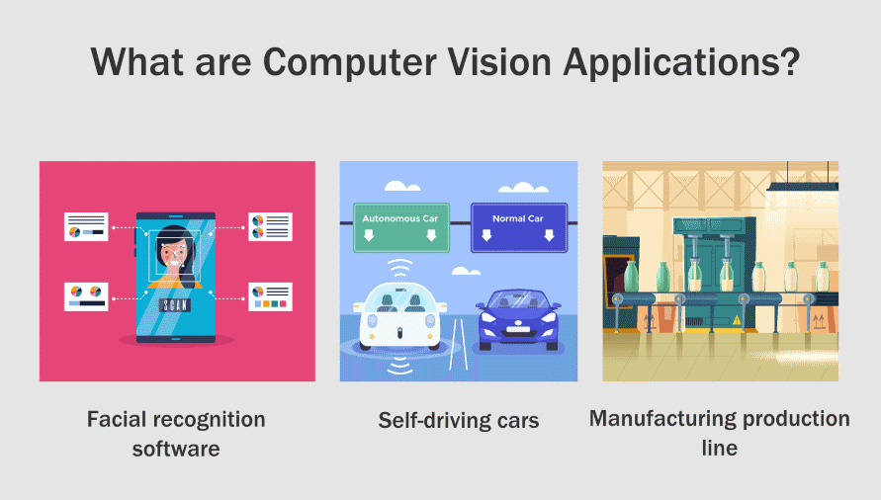

Slide 10
Examples
Retrieval of Images Based on Their Contents
Categorization of Images
Object Detection
Observation of Moving Objects

Slide 11
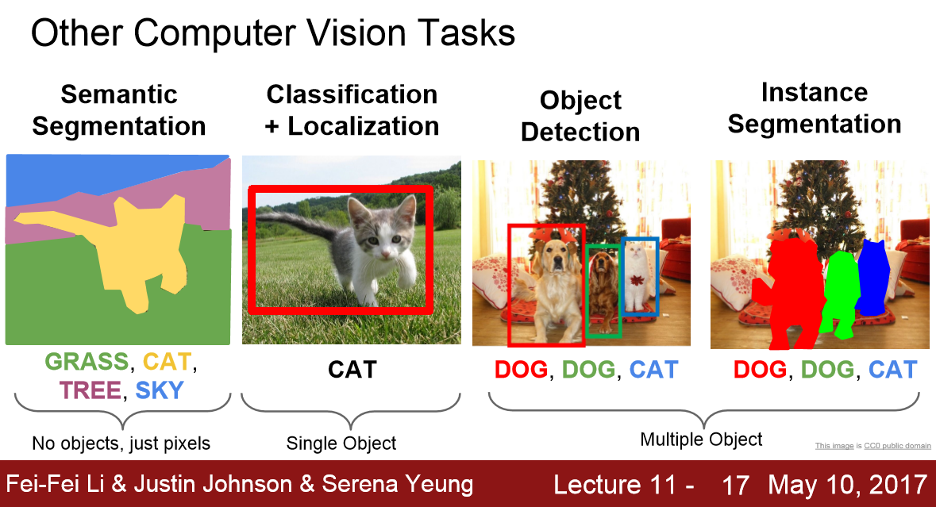

Slide 12
Computer Vision Algorithms
Object Classification - What is the main category of the object present in this photograph?
Object Identification - What is the type of object present in this photograph?
Object Detection - Where is the object in the photograph?
Object Segmentation - What pixels belong to the object in the image?
Object Verification - Is the object in the photograph?
Object Recognition - What are the objects present in this photograph and where are they located?
Object Landmark Detection - What are the key points for the object in this photograph?

Slide 13
Challenges of Computer Vision?
Creating a machine with human-level vision is surprisingly challenging, and not only because of the technical challenges involved in doing so with computers. We still have a lot to learn about the nature of human vision.
To fully grasp biological vision, one must learn not just how various receptors like the eye work, but also how the brain processes what it sees. The process has been mapped out, and its tricks and shortcuts have been discovered, but, as with any study of the brain, there is still a considerable distance to cover.

Slide 14
Computer Vision Benefits
Faster and simpler process.
Better products and services.
Cost-reduction.

Slide 15
Computer Vision Disadvantages
Lack of specialists.
Need for regular monitoring.

Slide 16
What Is an Image?
An image is represented by its dimensions (height and width) based on the number of pixels. For example, if the dimensions of an image are 500 x 400 (width x height), the total number of pixels in the image is 200000.
his pixel is a point on the image that takes on a specific shade, opacity or color. It is usually represented in one of the following:
Grayscale - A pixel is an integer with a value between 0 to 255 (0 is completely black and 255 is completely white).
RGB - A pixel is made up of 3 integers between 0 to 255 (the integers represent the intensity of red, green, and blue).
RGBA - It is an extension of RGB with an added alpha field, which represents the opacity of the image.

Slide 17
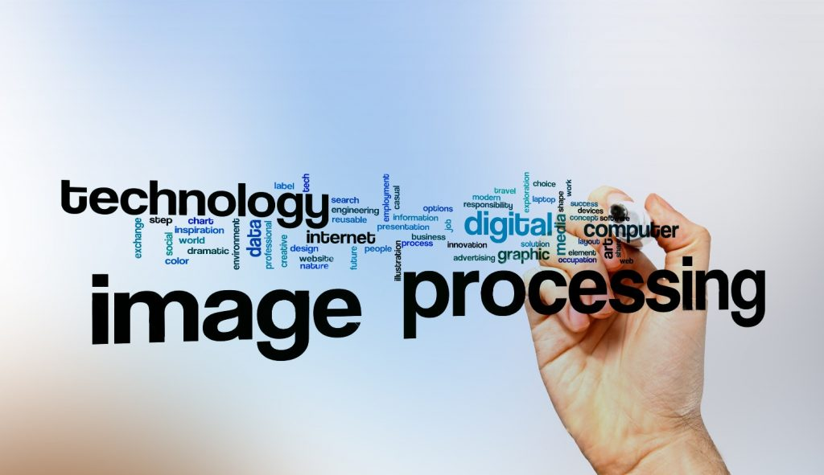

Slide 18
Types of Image Processing
There are five main types of image processing:
Visualization - Find objects that are not visible in the image
Recognition - Distinguish or detect objects in the image
Sharpening and restoration - Create an enhanced image from the original image
Pattern recognition - Measure the various patterns around the objects in the image
Retrieval - Browse and search images from a large database of digital images that are similar to the original image

Slide 19
Fundamental Image Processing Steps
Image Acquisition
Image Enhancement
Image Restoration
Image Restoration
Color Image Processing
Wavelets and Multiresolution Processing
Compression
Morphological Processing
Segmentation
Representation and Description
Recognition

Slide 20
Applications of Image Processing
Face Detection
Medical Image Retrieval
Traffic Sensing Technologies
Image Reconstruction

Slide 21
Medical Image Retrieval
Image processing has been extensively used in medical research and has enabled more efficient and accurate treatment plans.
For example, it can be used for the early detection of breast cancer using a sophisticated nodule detection algorithm in breast scans. Since medical usage calls for highly trained image processors, these applications require significant implementation and evaluation before they can be accepted for use.

Slide 22
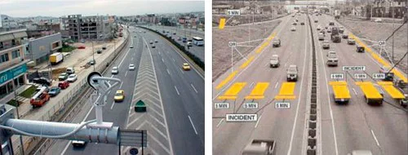
Traffic Sensing Technologies
In the case of traffic sensors, we use a video image processing system or VIPS.
This consists of
an image capturing system
b) a telecommunication system and
c) an image processing system.
When capturing video, a VIPS has several detection zones which output an “on” signal whenever a vehicle enters the zone, and then output an “off” signal whenever the vehicle exits the detection zone. These detection zones can be set up for multiple lanes and can be used to sense the traffic in a particular station.
Left - normal traffic image | Right - a VIPS image with detection zones

Slide 23
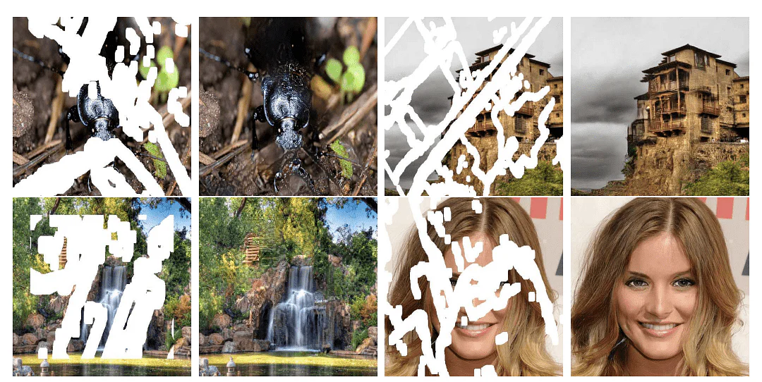
Image Reconstruction
Image processing can be used to recover and fill in the missing or corrupt parts of an image. This involves using image processing systems that have been trained extensively with existing photo datasets to create newer versions of old and damaged photos.

Slide 24
Face Detection
One of the most common applications of image processing that we use today is face detection. It follows deep learning algorithms where the machine is first trained with the specific features of human faces, such as the shape of the face, the distance between the eyes, etc. After teaching the machine these human face features, it will start to accept all objects in an image that resemble a human face. Face detection is a vital tool used in security, biometrics and even filters available on most social media apps these days.

Slide 25
Benefits of Image Processing
The implementation of image processing techniques has had a massive impact on many tech organizations. Here are some of the most useful benefits of image processing, regardless of the field of operation:
The digital image can be made available in any desired format (improved image, X-Ray, photo negative, etc)
It helps to improve images for human interpretation
Information can be processed and extracted from images for machine interpretation
The pixels in the image can be manipulated to any desired density and contrast
Images can be stored and retrieved easily
It allows for easy electronic transmission of images to third-party providers

Slide 26
Thank You
References:
https://www.simplilearn.com/computer-vision-article
https://www.simplilearn.com/image-processing-article

